Slide 1


Nested Classes and Threads
SAMAR MANSOUR

Slide 2

Nested Classes

Slide 3
Types of Java Inner Class
Earlier we learned about classes and objects. These are an integral part of programming in Java. However, it is very important to know that classes, just like loops, are nested, i.e. one class definition inside another class.
Inner classes in Java are the classes that are defined inside the scope of another class. Inner classes are also called nested classes. This helps in easy documentation and better maintenance of the code.
4 Types of inner classes:
Nested inner class
Method local inner class
Anonymous inner class
Static nested classes

Slide 4
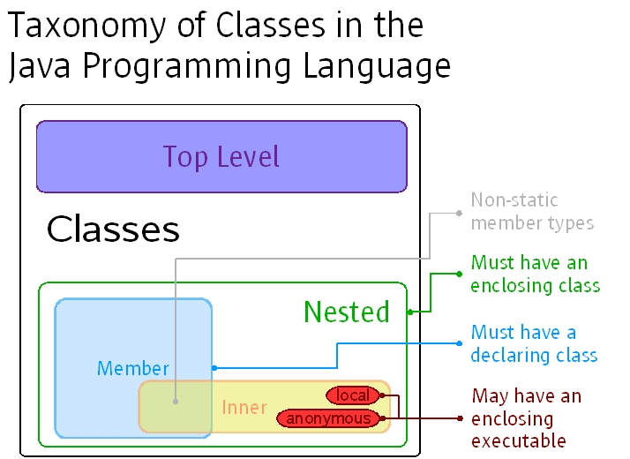

Slide 5
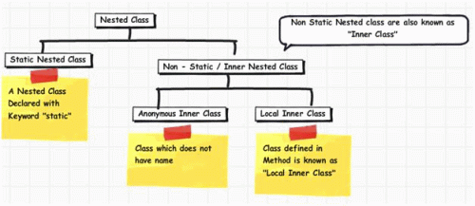

Slide 6
Needs of Inner classes
Sometimes you will need to program a class in such a way so that no other class can access it. Hence it would be better if you enclose it within other classes.
If all the class objects are a part of the outer object then it is easier to nest that class inside the outer class. That way all the outer class can access all the objects of the inner class.
Syntax:
public class OuterCLass {
//outer code
public class innerClass {
//Inner class code
}
}

Slide 7
Nested inner class
As the name suggests, this type of inner class involves the nesting of a class inside another class. The inner class can access the private variables of the outer class.
We can modify access to the inner class by using access modifier keywords such as private, protected, and default. Similarly, access specifiers can help nest interfaces inside one another.

Slide 8
Nested inner class - Example
class OuterClass {
public class InnerClass {
public void print() {
System.out.println("I am printing from the inner class!");
}
}
}
public class NestedInnerClass {
public static void main(String[] args) {
OuterClass.InnerClass in =new OuterClass().new InnerClass();
in .print();
}
}

Slide 9
Note: Nested inner class
One thing to remember that even though we can have nested static classes, we cannot have methods that are static inside the nested classes. Because all the methods of the nested class are implicitly connected to the object of its outer enclosing class. Hence they cannot declare any static methods for themselves.

Slide 10
Static nested classes
If you declare the inner class to be static, then you can access the class without having to create an object of the outer class. However, the static class will not have access to members of the outer class. We can access the elements of the outer class from the inner class.

Slide 11
Static nested classes - Example
class OuterClass {
public static class InnerClass {
public void print() {
System.out.println("I am printing from a static inner class!");
}
}
}
public class StaticInnerClass {
public static void main(String[] args) {
OuterClass.InnerClass in =new OuterClass.InnerClass();
in .print();
}
}

Slide 12
Method Local Inner Classes
Up until now, we have seen classes coded inside other classes. In the case of method local inner classes, the outer class method contains the inner class.
However, the inner class cannot use the variables of the outer class if they are not declared as final values. This rule was prevalent until JDK 1.7. After that, inner classes can access non-final local variables.

Slide 13
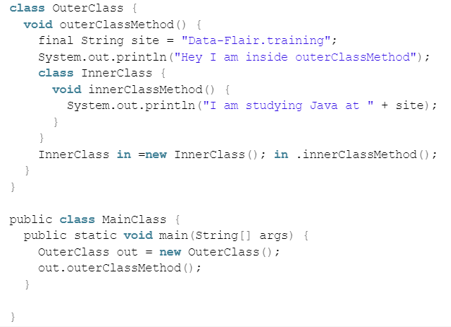
Example
Note: If you are using JDK 1.7 or below, removing the final keyword will give you an error like this:
The code inside the inner class is trying to access the local variable named site. The error will be rectified if you declare the variable as final.

Slide 14
Anonymous Inner Classes
As the name suggests these inner classes have no name at all. The definition of the classes are written outside the scope of the outer class. These classes are useful when we have to design an interface or overload a method. It saves the effort of us having to nest the class.
They are of two types.
Subclass of the specified type:
The anonymous class is put inside a subclass of the outer class. The subclass serves the function as illustrated below.
b. The implementer of the specified interface:
The anonymous class can extend a class or implement an interface at a time.

Slide 15
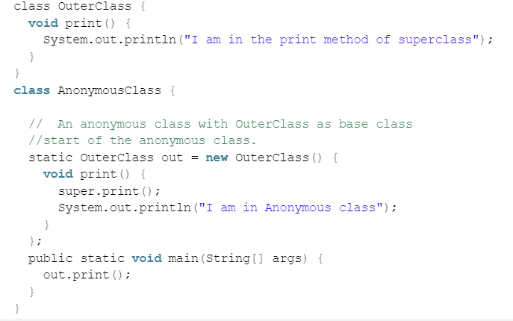
Subclass of the specified type - Example

Slide 16
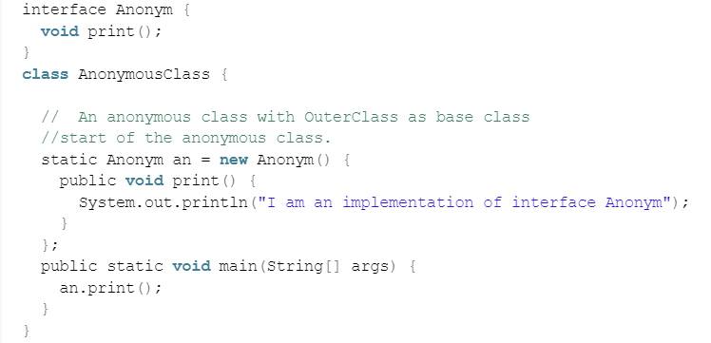
The implementer of specified Interface - Example

Slide 17
Conclusion:
Anonymous class: handy for productivity
They are handy to implement callbacks easily, without the burden to create new named class.
Static nested class: handy for encapsulation:
Static nested classes are essentially like regular classes, except that their name is calling name in main like: “OuterClass.StaticNestedClass”, and you can play with modifier. So it provided some form of encapsulation that can not exactly be achieved with top-level classes.
Inner class: handy for ownership and encapsulation:
An instance of an inner class has access to the field of its enclosing class instance

Slide 18
Threads

Slide 19
Concept before we learn threads
Application is a program which is designed to perform a specific task. For example, MS Word, Google Chrome, a video or audio player etc.
Process is an executing instance of an application. For example, when you double click MS Word icon in your computer, you start a process that will run this MS word application. Processes are heavy weight operations that they require their own separate memory address in operating system. Because of the processes are stored in separate memory, communication between processes (Inter Process Communication) takes time. Context switching from one process to another process is also expensive.

Slide 20
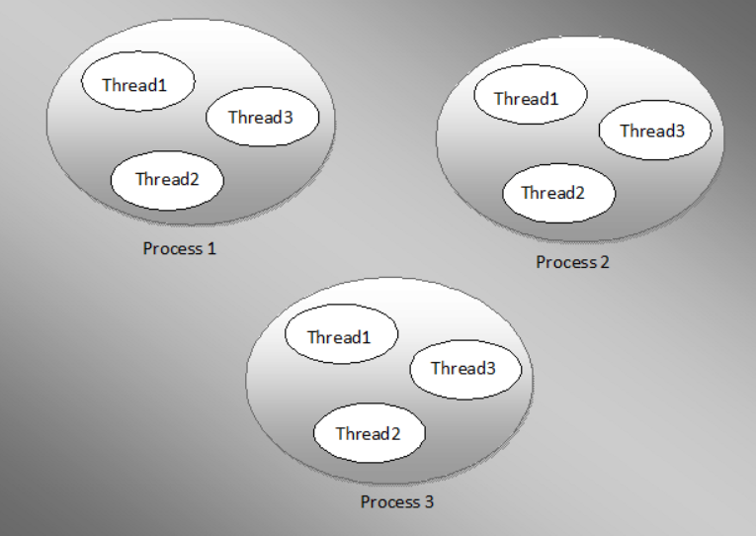
threads

Slide 21
Concepts
Multitasking is the ability to perform several tasks simultaneously and it divided into process based and thread based.
Multiprocessing is the ability to run more than one process (application) at the same time. An example is running Excel and Photoshop at the same time.
Multithreading is the ability to perform more than one activity within the same process. An example is using your web browser (a process) to read info on internet, send an email and download a file. Those are three threads within one process(application).

Slide 22
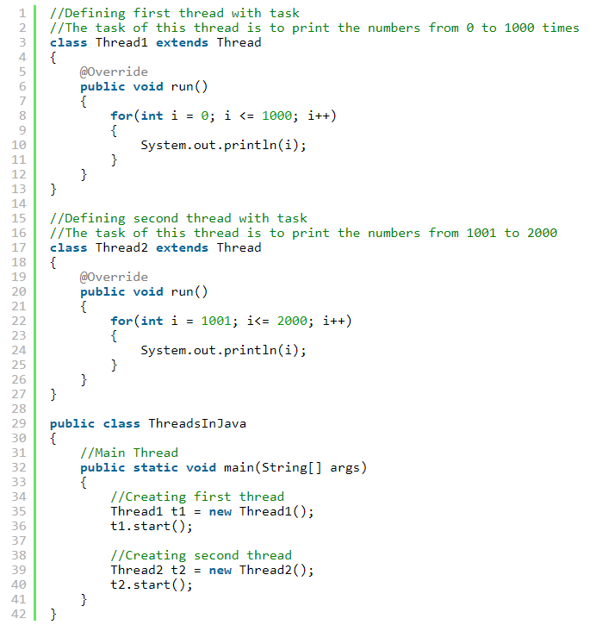
Example

